Slide 1
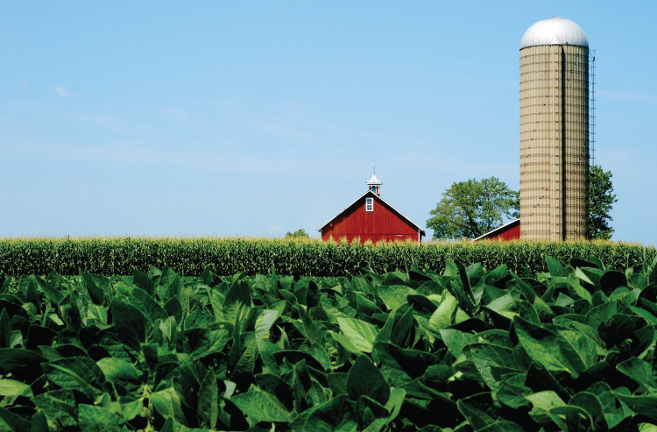

FINAL PRESENTATION
FARMER RISK PREFERENCES
An Analysis of Illinois Farmland Lease Types and Crop Insurance Coverage
Megan Finfrock, Caden Heyen, Caleb Reed, Cassidy Thomas, Jake Toma

Slide 2

RISK BALANCING
Risk Balancing Concept
Sources of Risk: Business Risk & Financial Risk
Total Risk Preference Level
Maximize Net Returns Subject to Individual Risk Preference Constraint
Role of Risk Balancing in Land Rental Agreement Decisions
Cash Rent vs. Share Rent
Possible explanation - Crop Insurance

Slide 3
BACKGROUND
Lengthy history of crop insurance in the U.S.
But the 1980 Act set forth a substantive crop insurance program
Establishment of RMA
Transition from share-rented to cash-rented farmland in Illinois
Trends toward more risk-taking farmers - why?
Increased crop insurance coverage and reduced risk: revenue protection

Slide 4
DATA
Time frame -
2003 - 2020
Publicly Available
Illinois Farm Business Farm Management (FBFM) System
County-level
Financial information
Number of acres for each lease type
USDA RMA Summary of Business
State-, county-, & crop-level
Coverage types and levels

Slide 5
RESULTS
1. Increase in Cash Rent, Decrease in Share Rent (State Level)
2. Increase in Cash Rent, Decrease in Share Rent (County Level)
3. Increase in Crop Insurance Coverage (State Level)
4. Increase in Average Coverage Level (%)
5. Increase in Crop Insurance Coverage (County Level)

Slide 6
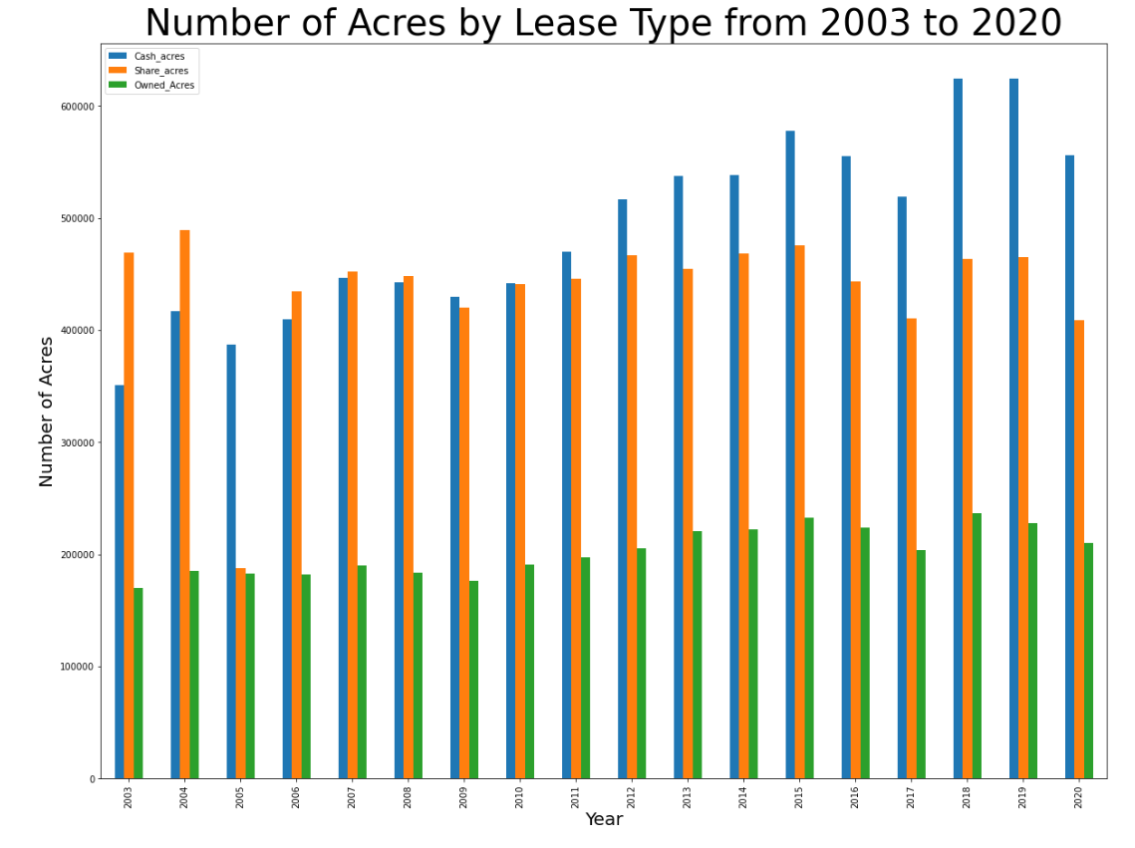

1. INCREASE IN CASH RENT

Slide 7
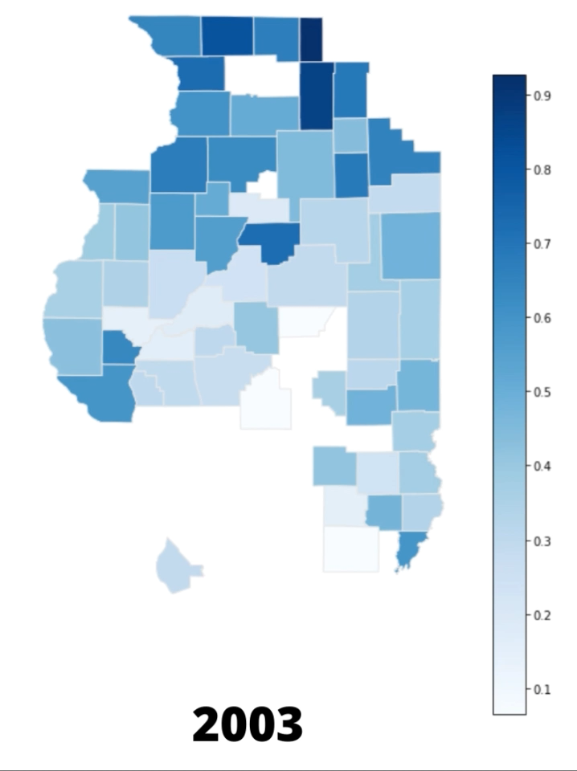
2. VISUALIZATION OF ILLINOIS COUNTIES AND THE INCREASE IN CASH RENT

Slide 8
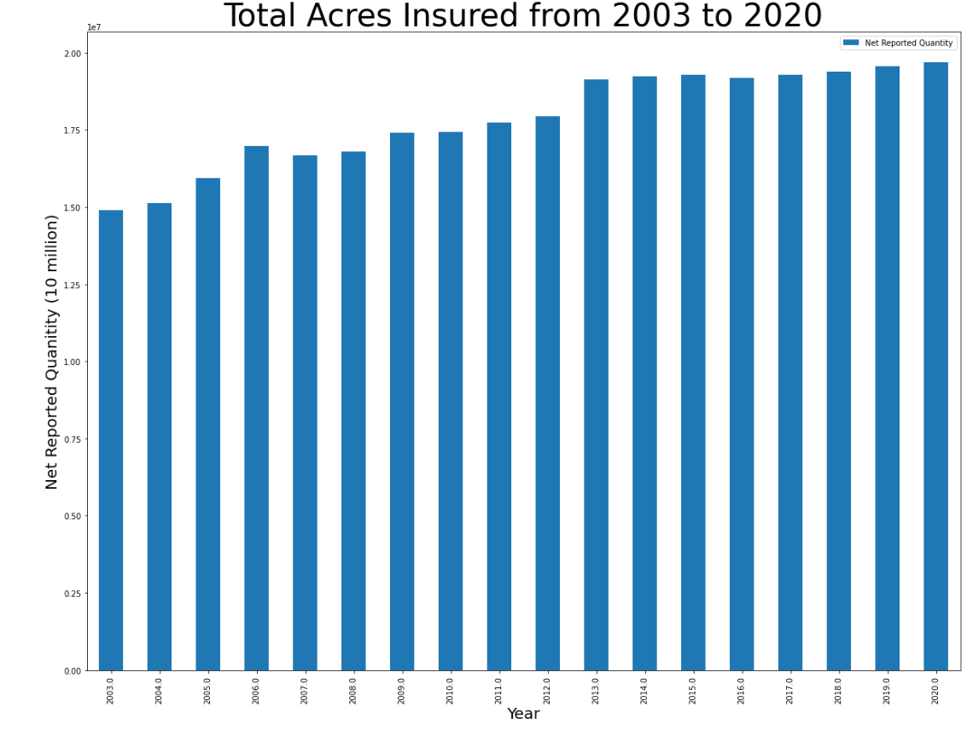
3. INCREASE IN CROP INSURANCE USAGE

Slide 9
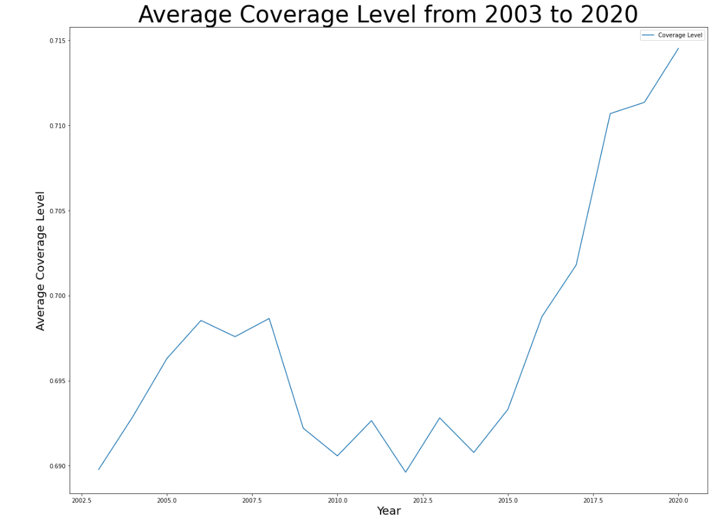

4. INCREASE IN AVERAGE COVERAGE LEVEL

Slide 10
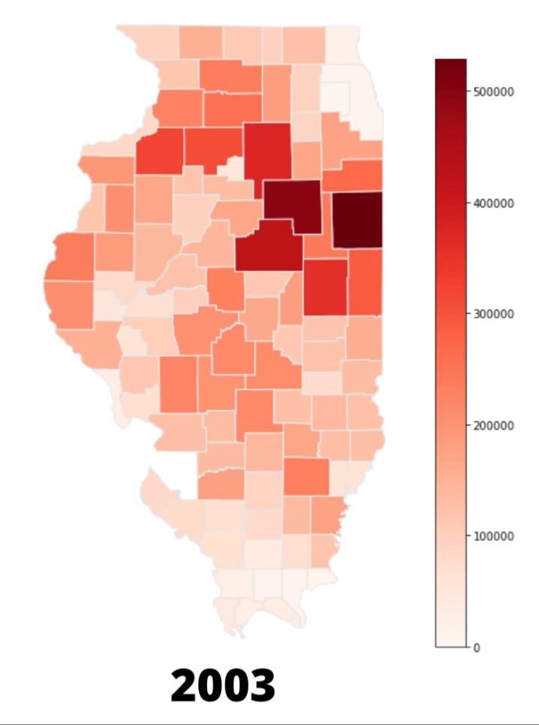
5. VISUALIZATION SHOWING COUNTY LEVEL CROP INSURANCE USAGE

Slide 11
FBFM Limitations
Farm Incomes after Introducing Crop Insurance
MISSING DATA
Natural Occurrences: Climate Variation & Pests
Economic and Political Impact
Size of Farm Bias

Slide 12
CONCLUSION
Increase in Cash Rent and Decrease in Share Rent
Increase in Use of Crop Insurance
Risk Preference of Illinois Farmer
State and County Level
What does this mean?
State and County Level
Why is this happening?
Farmers becoming more risk-taking
How can we draw this correlation?

